Slide 1
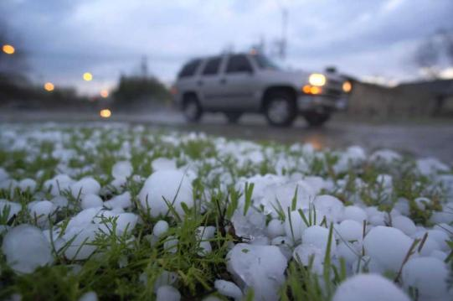
EERF 6395: RF and Microwave Systems Engineering Final Project
INTELLIGENT HAILSTORM DETECTION AND WARNING SYSTEM
GROUP 2
Nadiah Sarfraz (5G TX) Niyati Sanandiya (Radar RX ) Nirjari Shukla (5G RX) Varsha Paul (Radar TX)

Slide 2
Table of Contents
Problem Statement & Solution
System Architecture
Radar Block Diagram
Communication Link Block Diagram
Radar TX Channel
5G Communication RX Channel
Drone Specifications
System Issues
Project Implementation Plan

Slide 3
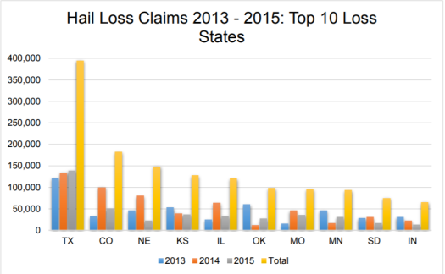
Problem Statement
In 2017, National Oceanic and Atmospheric Administration, NOAA’s National Weather Service estimated about 6045 hailstorms.
In 2016, Hailstorms caused about 21 injuries , around $3.51 billion property damage, 23.73 million crop damage, which gives total of $3.53 billion damage.
Texas suffered from Hail damage cost of approximately $138,539 in 2015.

Slide 4
Solution
Our system aims at reducing these damages as much as possible by proactively detecting hail and sending alert messages to people.
Drone detects weather condition by an inbuilt radar system and triggers the communication link.
Weather monitoring station sends alert messages to people using 5G communication link.
Weather warnings can help people protect themselves and their property from adverse weather conditions.

Slide 5
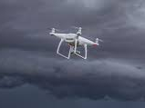


System Architecture
Drone triggers communication link
RADAR
Base station
5G communication link
Weather condition

Slide 6
Top-level Radar Specs
Parameter | Top-level Spec | Min/ Max
Frequency Band (GHz) | 14.5-15.5 | Min
Transmit Output Power (dBm) | 25 | Min
Transmit Channel Gain (dB) | 35 | Min
Transmit Channel PAE (%) | 35 | Min
Receive Noise Figure (dB) | 4.5 | Max
Receive Channel Gain (dB) | 35 | Min
Receive Channel OIP3 (dBm) | 25 | Min
Antenna Beamwidth (degrees) | +/-20 | Max
Range (m) with Target RCS=1.0m | 250 | Min
Total DC Power Consumption (W) | 10 | Max

Slide 7
Top-level Communication link Specifications
Parameter | Top-level Spec | Min/ Max
Frequency Band (GHz) | 23-25 | Min
Transmit Output Power (dBm) | 25 | Min
Transmit Channel Gain (dB) | 15 | Min
Transmit Channel PAE (%) | 25 | Min
Receive Noise Figure (dB) | 5 | Max
Receive Channel Gain (dB) | 15 | Min
Receive Channel OIP3 (dBm) | 20 | Min
TX Antenna Az Beamwidth (degrees) | +/-5 | Max
RX Antenna Az Beamwidth (degrees) | +/-5 | Max
Range (m) | 5000 | Min
Total DC Power Consumption (W) | 10 | Max

Slide 8

RADAR TRANSMITTER
ANTENNA
SIGNAL
SOURCE
LPF
BPF
PA
IF
DA
PA
MIXER
LOCAL OSCILLATOR

Slide 9

RADAR RECEIVER
ANTENNA
BPF
Image Reject Filter
IF BPF
LNA
IF
Received Signal
MIXER
LOCAL OSCILLATOR

Slide 10


RADAR TRANSCEIVER
SIGNAL
SOURCE
LPF
BPF
IF
DA
PA
MIXER
CIRCULATOR
LOCAL OSCILLATOR
Received Signal
IF BPF
Image Reject
Filter
BPF
IF
LNA

Slide 11
COMMUNICATION LINK TRANSMITTER
ANTENNA
SIGNAL
INPUT
MODULATOR
LPF
BPF
IF
DA
PA
MIXER
LOCAL OSCILLATOR

Slide 12
COMMUNICATION LINK RECEIVER
ANTENNA
BPF
Image Reject Filter
LPF
DEMODULATOR
PROCESSING UNIT
LNA
IF
MIXER
LOCAL OSCILLATOR

Slide 13
RADAR LINK

Slide 14
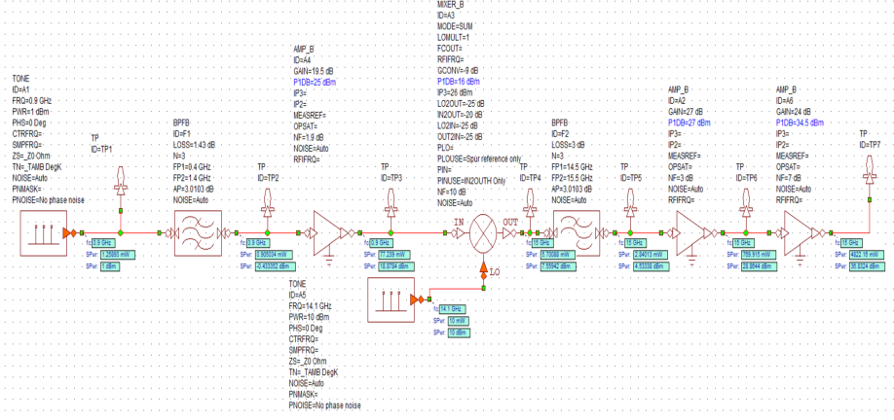
RADAR TRANSMITTER SCHEMATIC

Slide 15
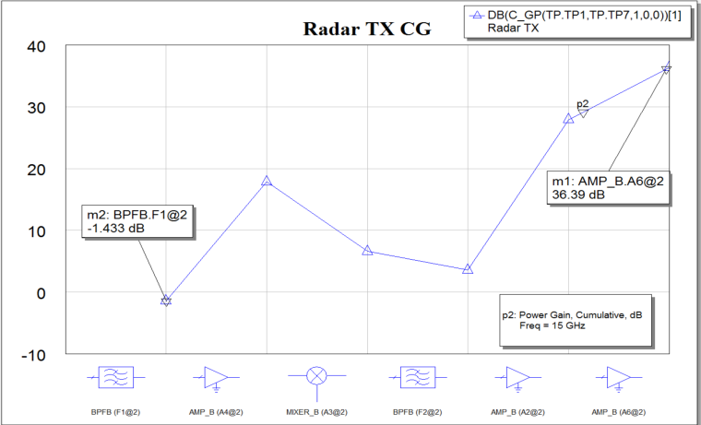
Cascaded Gain (C_GP) (dB)

Slide 16
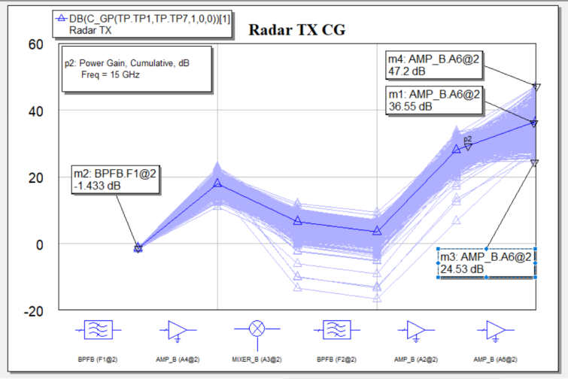
Yield Analysis Cascaded Gain (C_GP) (dB)

Slide 17
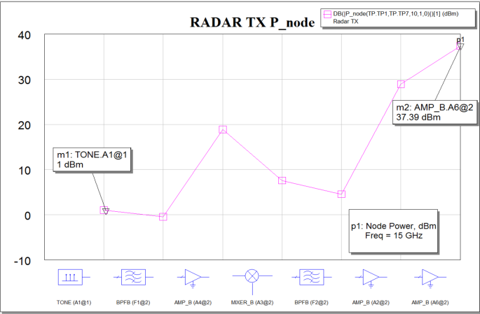
Cascaded Node Power (P_node) (dBm)

Slide 18
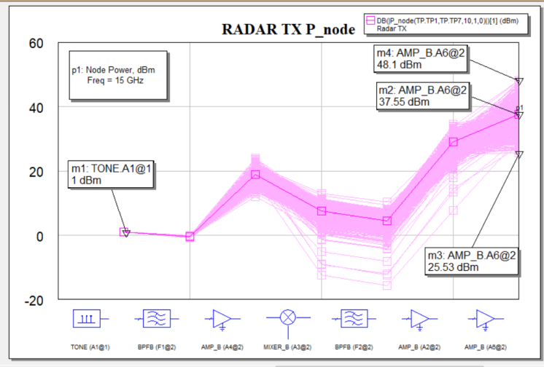
Yield Analysis Cascaded Node Power (P_node) (dBm)

Slide 19
Components used in
Radar Transmitter

Slide 20

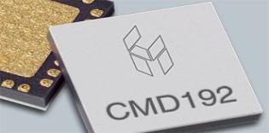
.
DRIVER AMPLIFIER
OPERATING FREQUENCY RANGE | 0-20 Ghz
GAIN(dB) | 19.5
NOISE FIGURE(dB) | 1.9
P1 dB(dB) | 25

Slide 21
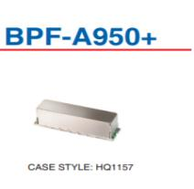

.
OPERATING FREQUENCY RANGE | 0.4-1.4 Ghz
INSERTION LOSS(dB) | 1.43

Slide 22
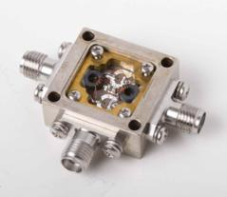

.
MIXER
LTC 5553
OPERATING FREQUENCY RANGE | 3-20 Ghz
CONVERSION LOSS | 9 dB

Slide 23
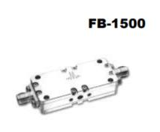

.
BANDPASS FILTER
OPERATING FREQUENCY RANGE | 14.5-15.5 Ghz
LOSS | 3 dB

Slide 24
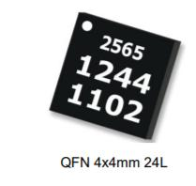

.
POWER AMPLIFIER
TGA 2565-SM
OPERATING FREQUENCY RANGE | 11-17 Ghz
GAIN | 27 dB
P1dB | 27 dB
NOISE FIGURE | 3

Slide 25

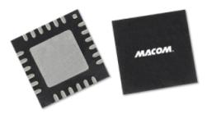

.
MAAP-010517
OPERATING FREQUENCY RANGE | 14.4-15.4 Ghz
GAIN | 24 dB
P1dB | 34.5 dB
NOISE FIGURE | 7 dB

Slide 26
Power Added Efficiency Calculation
Pin=1.258 mW
Pout=4822.16 mW
Pdc=1W+1.6W+0.436W+6W+1.260W+1W
=11.296W
PAE=(Pout-Pin)/Pdc*100 %
=(4822.16-1.258)/11.296 * 100 %
PAE =42.67%

Slide 27
EIRP(Effective Isotropic Radiated Power)
Pt= 36.83 dB => 4822.16 mW
Gt=20 dB =>100(in Linear)
EIRP= Pt+ Gt
=36.83+20 dBm
=56.83 dBm
EIRP(in W)=481.94 W
EIRP(in dBW)=26.83 dBW

Slide 28
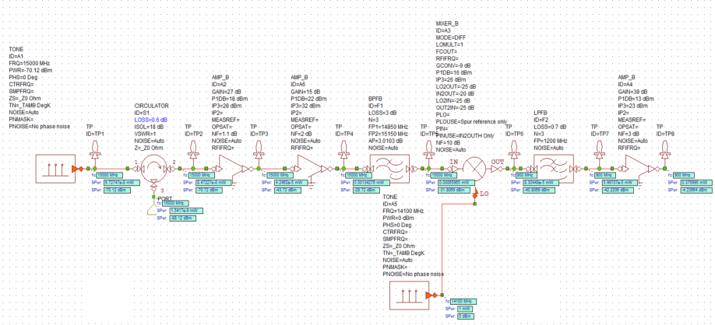
RADAR RECEIVER SCHEMATIC

Slide 29
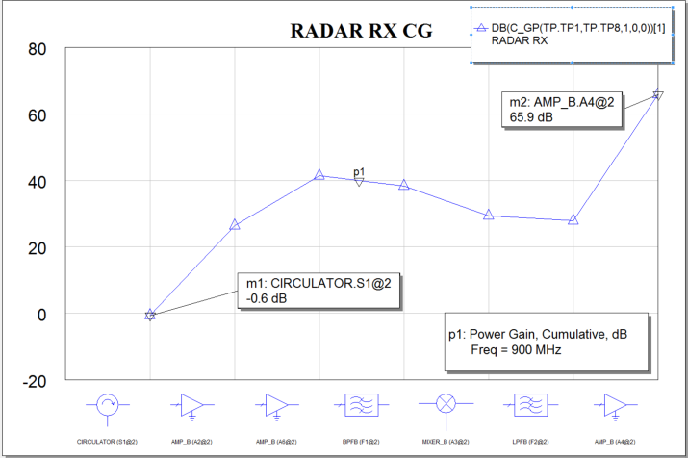
Cascaded Gain (C_GP) (dB)

Slide 30
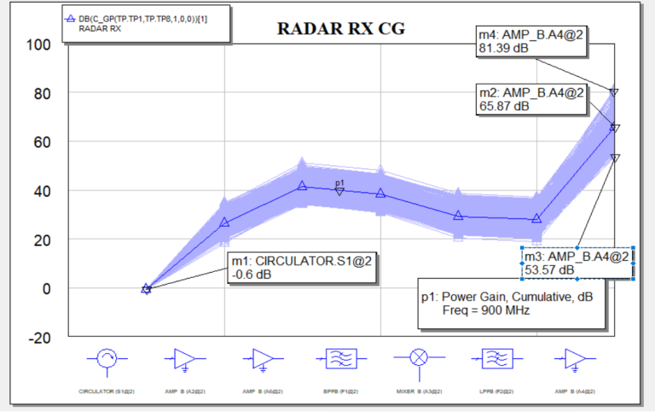
Yield Analysis Cascaded Gain (C_GP) (dB)

Slide 31
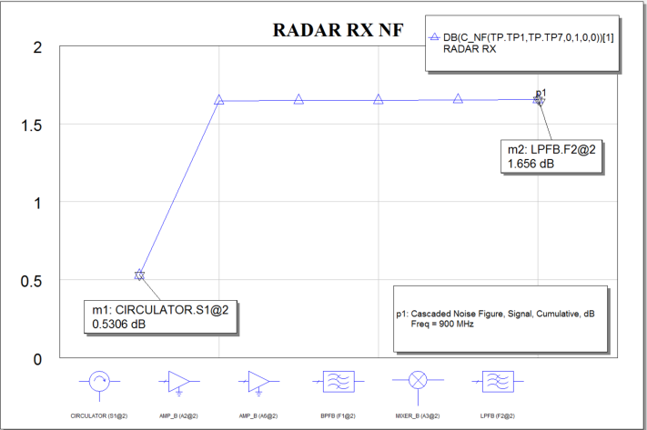
Cascaded Noise Figure (C_NF) (dB)

Slide 32
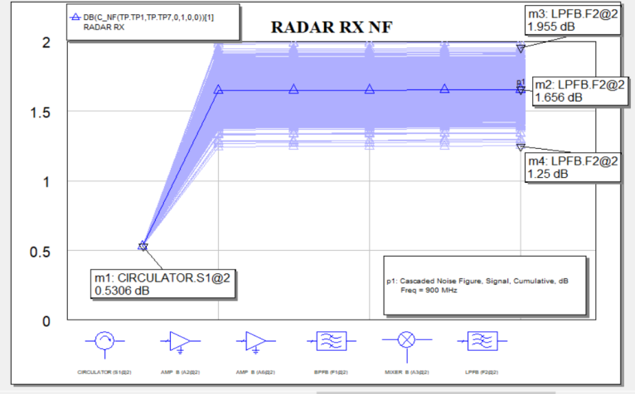
Yield Analysis Cascaded Noise Figure (C_NF) (dB)

Slide 33
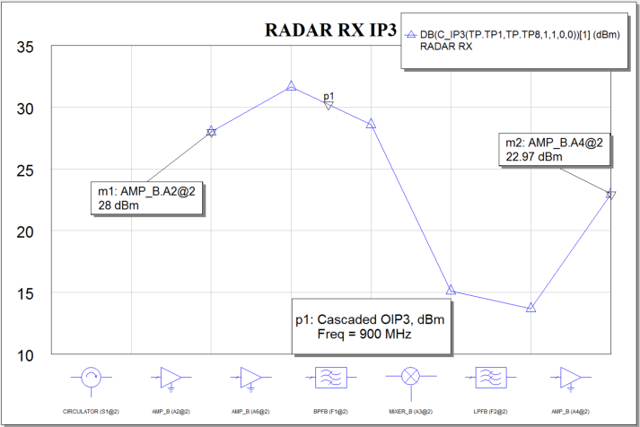
Cascaded IP3 (C_IP3) (dBm)

Slide 34
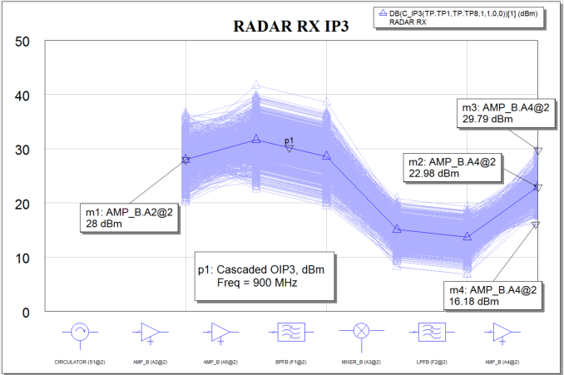
Yield Analysis Cascaded IP3 (C_IP3) (dBm)

Slide 35
Components used in
Radar Receiver

Slide 36


LOW PASS FILTER
SKU-0711-025
OPERATING FREQUENCY RANGE | 0-1.2 Ghz
INSERTION LOSS | 0.7 dB

Slide 37
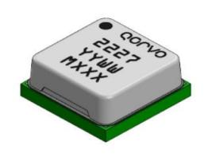

LOW NOISE AMPLIFIER
TGA-2227-5M
OPERATING FREQUENCY RANGE | 2-22 Ghz
GAIN | 15 dB
P1dB | 22 dB
NOISE FIGURE | 2 dB

Slide 38

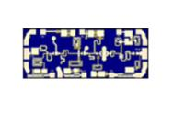
LOW NOISE AMPLIFIER
QPA-2609D
OPERATING FREQUENCY RANGE | 7-16 Ghz
P1dB | 18 dBm
GAIN | 27 dB
NOISE FIGURE | 1.1 dBm

Slide 39
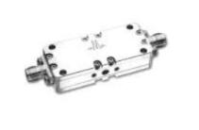

Bandpass filter
OPERATING FREQUENCY RANGE | 12-18 Ghz
CONVERSION LOSS | 3 dB

Slide 40

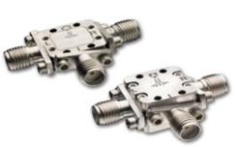
MIXER
LTC 5553
OPERATING FREQUENCY RANGE | 3-20 Ghz
CONVERSION LOSS | 9 dB

Slide 41

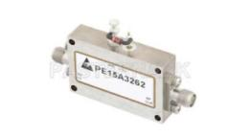
POWER AMPLIFIER
PE 15A3262
OPERATING FREQUENCY RANGE | 1-18 Ghz
GAIN | 30 dB
P1dB | 19 dB
NOISE FIGURE | 3.2 dB

Slide 42
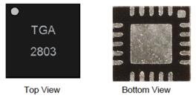

POWER AMPLIFIER
OPERATING FREQUENCY RANGE | 12-18Ghz
GAIN | 20 dB
P1dB | 37 dBm
NOISE FIGURE | 1.5 dB

Slide 43

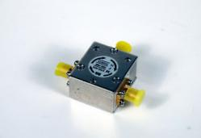
CIRCULATOR
KTMC-1502A2
OPERATING FREQUENCY RANGE | 14-18Ghz
GAIN | -0.6 dB
P1 Db | 20 dB
NOISE FIGURE | 3 dB

Slide 44
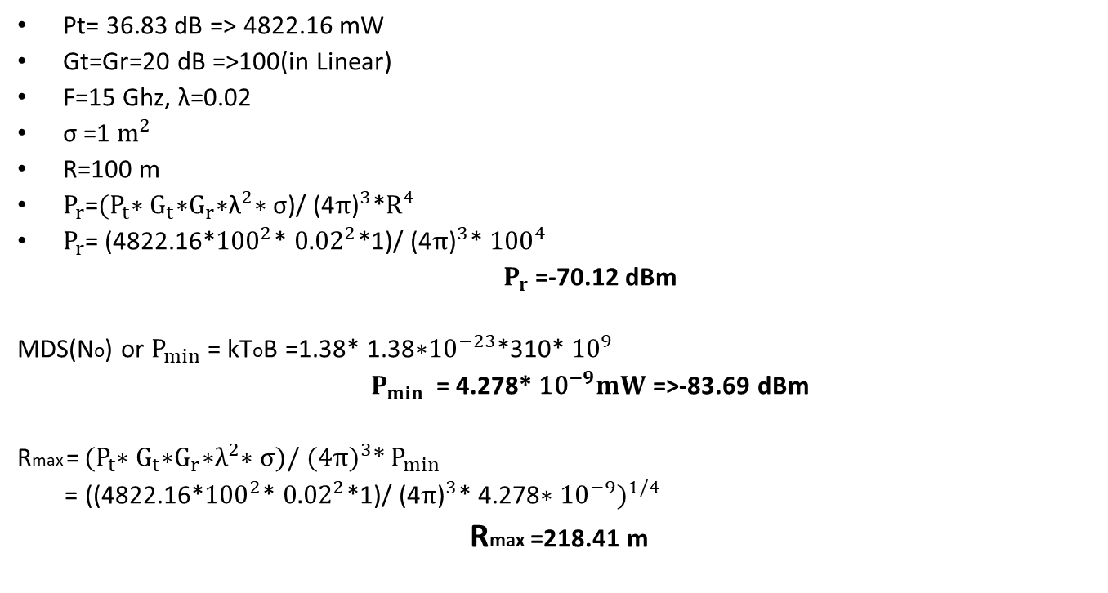
HAND CALCULATIONS
Pt= 36.83 dB => 4822.16 mW
Gt=Gr=20 dB =>100(in Linear)
F=15 Ghz, λ=0.02
σ =1 $m^{2}$
R=100 m
$P_{r}$=${(P}_{t}∗G_{t}\text{∗}G_{r}\text{∗}{\text{λ}}^{2}\text{∗ }\text{σ}\text{)}$/ ${\text{(4}π\text{)}}^{3}$*$R^{4}$
$P_{r}$= (4822.16*${100}^{2}$* ${\text{0.02}}^{2}$*1)/ ${\text{(4}π\text{)}}^{3}$* ${\text{100}}^{4}$
$P_{r}$=-70.12 dBm
MDS(No) or $P_{min}$= kToB =1.38* ${\text{1.38∗}10}^{−23}$*310* ${\text{10}}^{9}$
$P_{min}$ = 4.278* ${\text{10}}^{−9}mW$ =>-83.69 dBm
Rmax = ${(P}_{t}∗G_{t}\text{∗}G_{r}\text{∗}{\text{λ}}^{2}\text{∗ }\text{σ}\text{)}$/ ${\text{(4}π\text{)}}^{3}$* $P_{min}$
= ((4822.16*${100}^{2}$* ${\text{0.02}}^{2}$*1)/ ${\text{(4}π\text{)}}^{3}$* ${\text{4.278∗ }{\text{10}}^{−9})}^{1/4}$
Rmax =218.41 m

Slide 45

Free space path loss Calculation
R=100 m, $\text{λ}$=c/f,
=(3* ${\text{10}}^{8}$)/(15* ${\text{10}}^{9}$)=0.02 m
$FSPL$=$10log$ ${\text{(}\text{4}πR/{\text{λ}\text{)}}^{2}}^{.}$
= $10log$ ${\text{(}\text{4}π100/{\text{λ}\text{)}}^{2}}^{.}$
= 95.959 dBm
$FSPL=$ 95.959 dBm

Slide 46
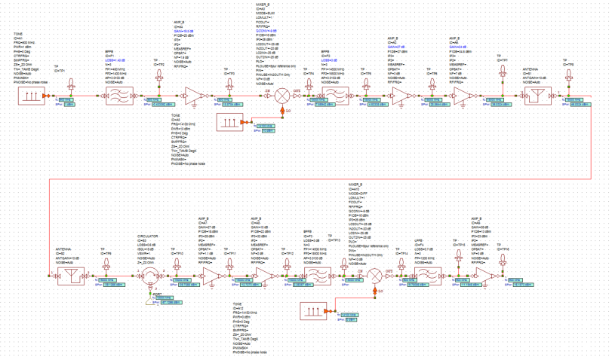
RADAR TRANSCEIVER SCHEMATIC

Slide 47
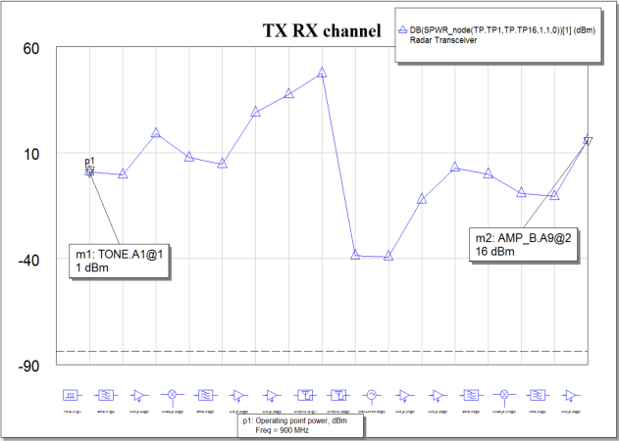
FSPL
FSPL
MDS=-83.69dBm

Slide 48
5G COMMUNICATION LINK

Slide 49
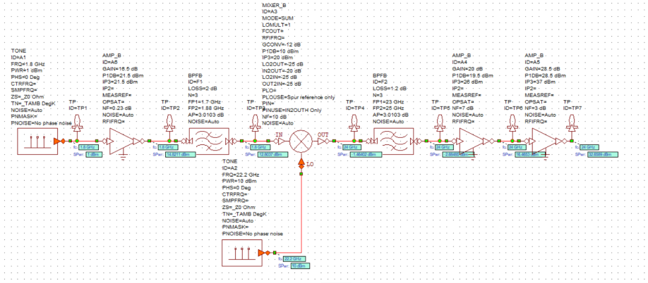
5G COMMUNICATION LINK TRANSMITTER SCHEMATIC

Slide 50
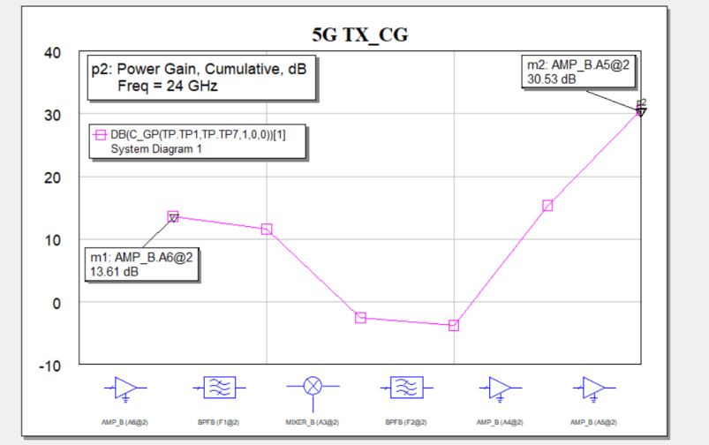
Cascaded Gain (C_GP) (dB)

Slide 51
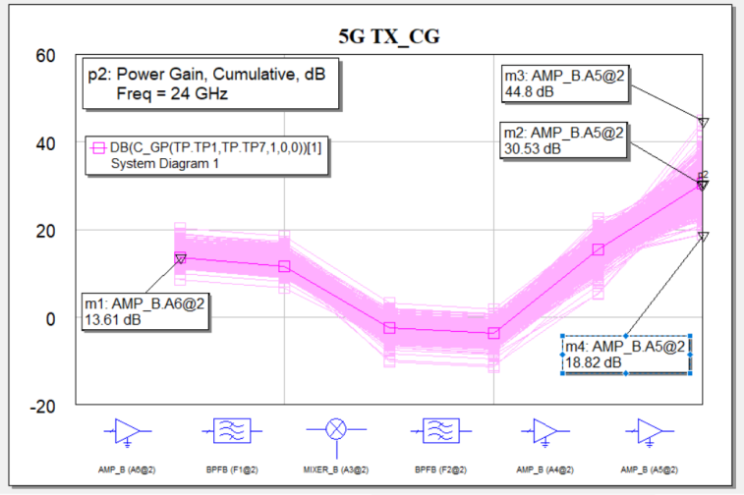
Yield Analysis Cascaded Gain (C_GP) (dB)

Slide 52
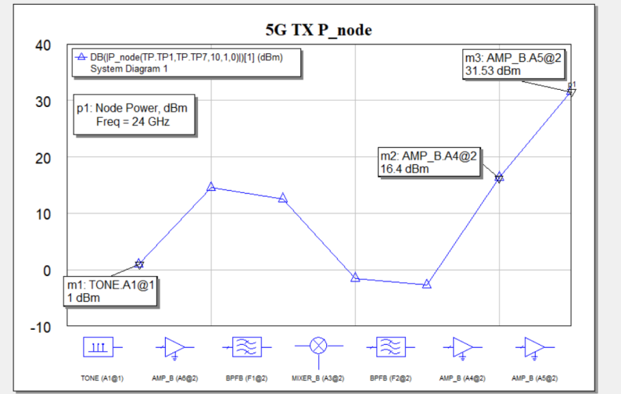
Cascaded Node Power (P_node) (dBm)

Slide 53
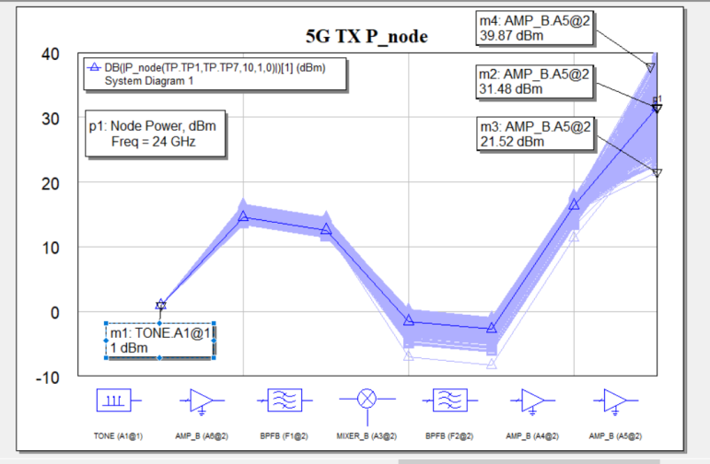
Yield Analysis Cascaded Node Power (P_node) (dBm)

Slide 54
Pdc = (5V*240mA) + (5V*650mA) + (4.5V * 50mA) = 4675mW Pout = 31.53dBm =1422.32 mW Pin = Pout – Gain = (31.53dBm – 30.53 dB) = 1 dBm = 1.25 mW PAE = ((Pout – Pin) / Pdc)*100 = 30.39% EIRP = Pt (dBm) + Gt (dB) = 31.53+ 24.7 dB = 56.23 dBm = 26.23 dBW (419.75 W)
5G Tx Channel Calculations

Slide 55
Components Used in 5G Transmitter

Slide 56

CGY2151HV_C1
Frequency | 1 GHz – 2 GHz
Gain | 16.5
Noise Figure | 0.23

Slide 57

Band Pass Filter
Frequency | 1.71 Ghz to 1.88 Ghz
Insertion Loss | 2 dB

Slide 58
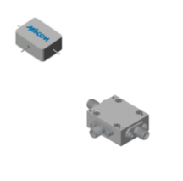


Mixer
RF frequency | 2 GHz -26 GHz
IF frequency | 1-15 Ghz
LO frequency | 2-26 Ghz
Conversion Loss | 12 dB
P1dB | 10 dBm

Slide 59
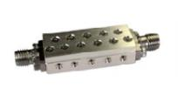

Band Pass Filter
Frequency | 18 Ghz to 30 Ghz
Insertion Loss | 1.2 dB

Slide 60


Driver Amplifier
Frequency range | 17 Ghz to 43 Ghz
Gain | 20 dB
P1dB | 19.5 dBm
Noise Figure | 7dB

Slide 61


Power Amplifier
Frequency | 18 to 26 GHz
Gain | 28.5 dB
IP3 | 37 dBm
P1dB | 28.5 dBm

Slide 62
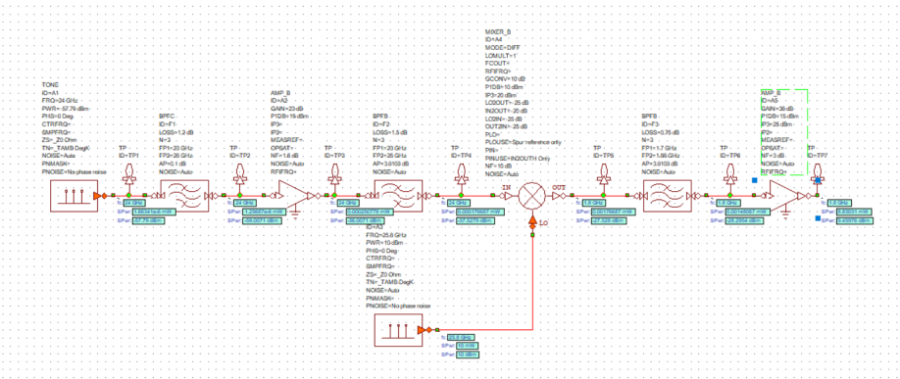
5G COMMUNICATION LINK RECEIVER SCHEMATIC

Slide 63
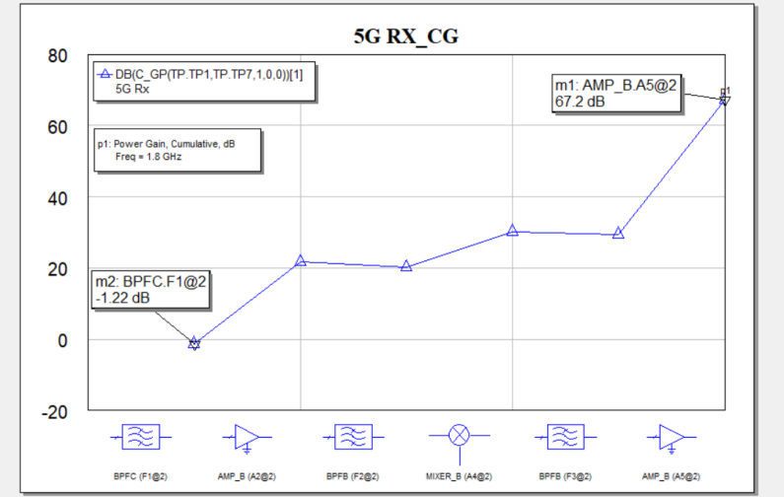
Cascaded Gain (C_GP) (dB)

Slide 64
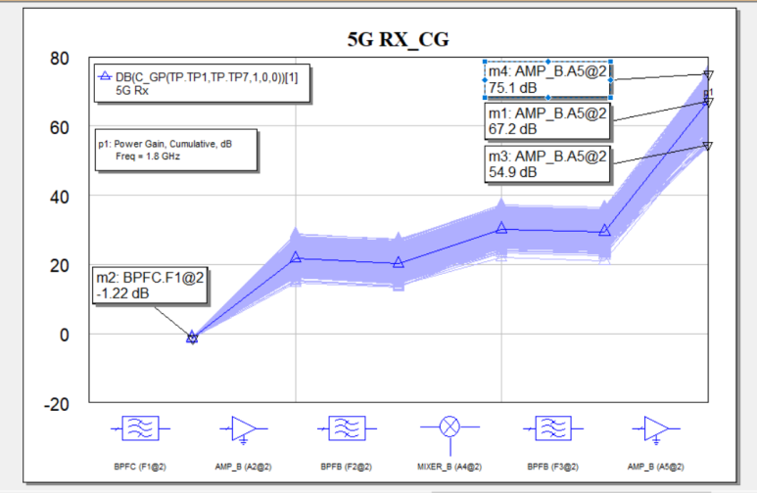
Yield Analysis Cascaded Gain (C_GP) (dB)

Slide 65
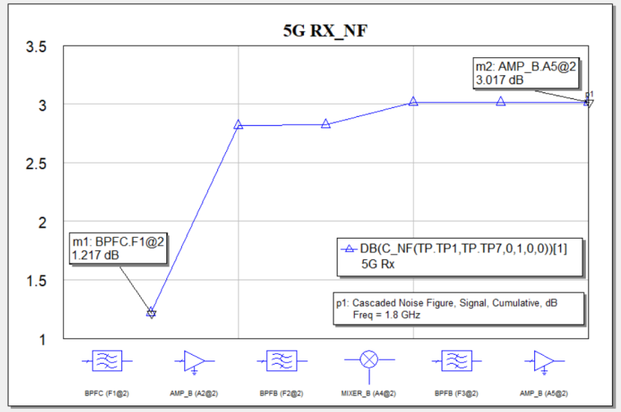
Cascaded Noise Figure (C_NF) (dB)

Slide 66
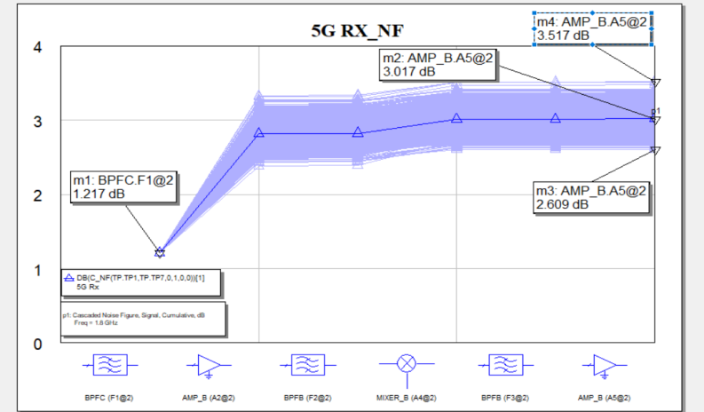
Yield Analysis Cascaded Noise Figure (C_NF) (dB)

Slide 67
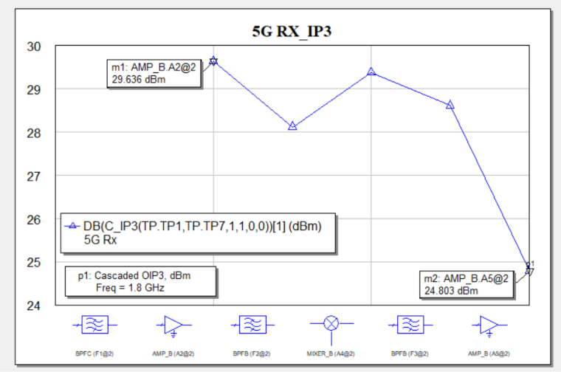
Cascaded IP3 (C_IP3) (dBm)

Slide 68
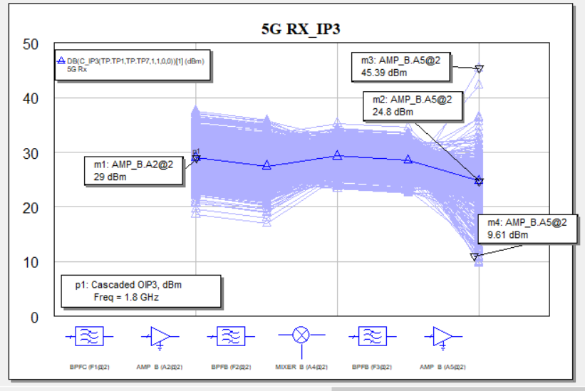
Yield Analysis Cascaded IP3 (C_IP3) (dBm)

Slide 69
Components used in 5G Receiver

Slide 70
Band Pass Filter
Frequency | 18 Ghz to 30 Ghz
Insertion loss | 1.2 dB

Slide 71
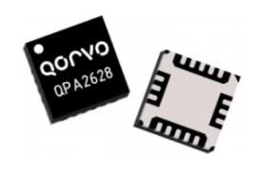


Low Noise Amplifier
Frequency | 22 Ghz to 32 Ghz
Noise Figure | 1.6 dB
Gain | 23 dB

Slide 72


Mixer
Rf frequency | 15 GHz -50 GHz
IF frequency | DC-5 Ghz
LO frequency | 15-50 Ghz
Conversion Loss | -10 dB
P1dB | 10 dBm

Slide 73


Band Pass Filter
Frequency | 18 GHz to 32 GHz
insertion loss | 1.5 dB

Slide 74


Low Noise Amplifier
Frequency | 15 Mhz to 3 Ghz
Gain | 38 dB
P1dB | 15 dBm

Slide 75

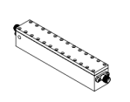
Band Pass Filter
frequency | 1.7 Ghz to 1.88 Ghz
center frequency | 1.8 GHz
insertion loss | 0.75 dB

Slide 76
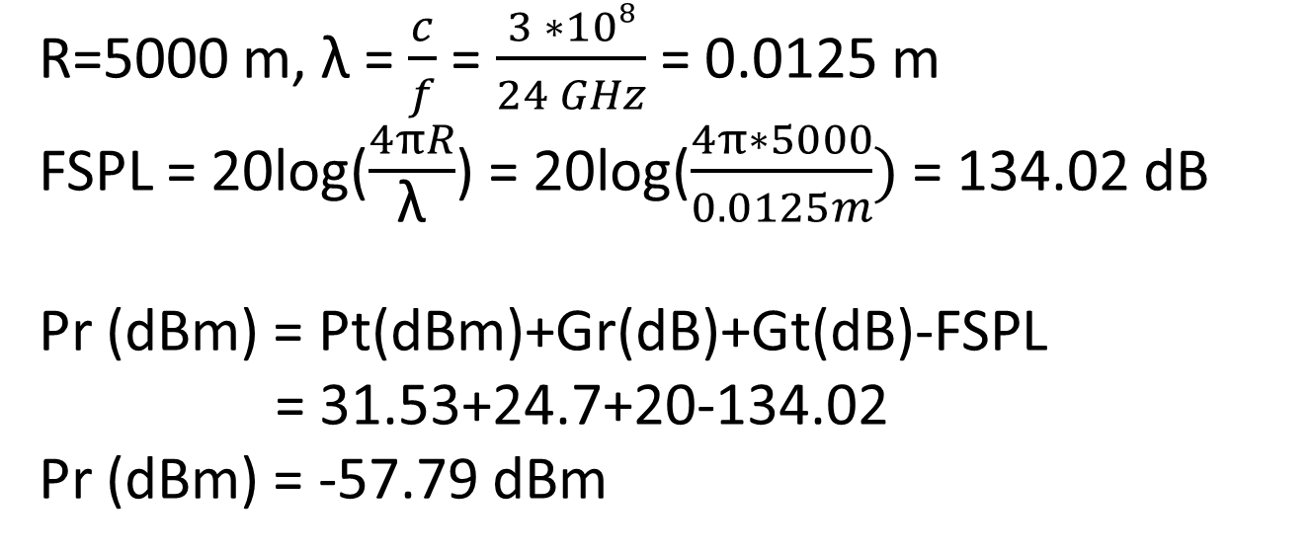
HAND CALCULATIONS
R=5000 m, λ = $\frac{c}{f}$ = $\frac{3 ∗108}{24 GHz}$ = 0.0125 m
FSPL = 20log($\frac{4πR}{\text{λ}}$) = 20log($\frac{4π∗5000}{0.0125m})$ = 134.02 dB
Pr (dBm) = Pt(dBm)+Gr(dB)+Gt(dB)-FSPL
= 31.53+24.7+20-134.02
Pr (dBm) = -57.79 dBm

Slide 77
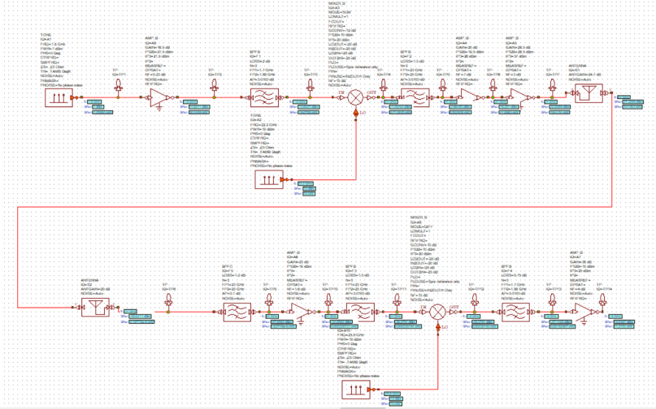
5G TRANSCEIVER SCHEMATIC

Slide 78

FSPL
FSPL
MDS=-83.69dBm

Slide 79
RADAR COMPLIANCE MATRIX
Parameter | Top-level Spec | Modified Spec | Min/ Max | Simulated Performance | Compliant (Y/N)
Frequency Band (GHz) | 14.5-15.5 | 14.5-15.5 | Min | 14.5-15.5 | Y
Transmit Output Power (dBm) | 12 | 25 | Min | 36.83 | Y
Transmit Channel Gain (dB) | 25 | 35 | Min | 36.39 | Y
Transmit Channel PAE (%) | 35 | 35 | Min | 42.67 | Y
Receive Noise Figure (dB) | 4.5 | 4.5 | Max | 1.656 | Y
Receive Channel Gain (dB) | 35 | 35 | Min | 66.7 | Y
Receive Channel OIP3 (dBm) | 20 | 20 | Min | 22.97 | N
Antenna Beamwidth (degrees) | 55 | 20 | Max | 18.9 | Y
Range (m) with Target RCS=1.0m | 250 | 250 | Min | 218.41 | N
Total DC Power Consumption (W) | 10 | 10 | Max | 11.29 | N

Slide 80
5G COMMUNICATION LINK COMPLIANCE MATRIX
Parameter | Top-level Spec | Modified Spec | Min/ Max | Simulated Performance | Compliant (Y/N)
Frequency Band (GHz) | 23-25 | 23-25 | Min | 23-25 | Y
Transmit Output Power (dBm) | 25 | 25 | Min | 31.53 | Y
Transmit Channel Gain (dB) | 15 | 15 | Min | 30.53 | Y
Transmit Channel PAE (%) | 25 | 25 | Min | 30.39 | Y
Receive Noise Figure (dB) | 5.0 | 5.0 | Max | 3.017 | Y
Receive Channel Gain (dB) | 15 | 15 | Min | 67.2 | Y
Receive Channel OIP3 (dBm) | 20 | 20 | Min | 24.803 | Y
TX Antenna Az Beamwidth (degrees) | +/-5 | +/-5 | Max | 17.5 | N
RX Antenna Az Beamwidth (degrees) | +/-5 | +/-5 | Max | 17.5 | N
Range (m) | 5000 | 5000 | Min | 5000 | Y
Total DC Power Consumption (W) | 10.0 | 10.0 | Max | 4.675 | Y

Slide 81

Drone Specifications
xFold Dragon Drone
Parameter | Top-level Spec
Maximum Range | 7000m
Cost | $31721
Cameras | 2x RED for 3D, Arri Alexa, Alexa M, F55
Payload capacity | 100lb safe (140lb stress)
Auto Return to Home | One-Key Go-Home
Operating Temp | 23 to 140 deg. F
Gear | Intelligent Landing Gear Function

Slide 82
UNIQUE FEATURES
Monitoring is possible due to the GPS feature present in the drone.
The drone has built in sensors and bright LEDs that prompts the status and remaining power of the battery in real time.
Drone continuously calculates its current distance from base station and the amount of power needed to return.
Alarm system is included to scare off the birds.
Our system uses a single drone for a given area. However, it can be expanded to have a network of drones working ‘smartly’ to detect hail.

Slide 83

Batteries for Drones
Brand | VENOM
Batteries material | Li-Po
Capacity | 22000mAh
Charge Rate | 1C (22 A)
Flight Duration | 60 Minutes
Weight | 2749g
Application | Drone

Slide 84
Battery Calculations
Total DC power of the RF components in the radar channels= P_{dc} = 20.98 W
Energy consumed in one flight duration: (P_{dc} * flight time) = (20.98 W * 60 mins)
= 20.98 Wh = 20980 mWh
Required Battery Capacity = Energy Consumed / Battery Voltage
= 20980 mWh / 22.2 V = 9536.36 mAh
Drone with a battery having capacity of 22000 mAh is used
Required Battery Capacity < Supplied Battery Capacity
The batteries on the drone supply enough power to the RF components

Slide 85



Environmental and Health Issues
Bandwidths and Operating frequency chosen comply to the FCC regulations
According to IEEE health standards the power radiated should be less than 10 mW/sq.cm
$$S_{avg}= \frac{P_{t} G_{t}}{4πR^{2}}$$
Power radiated for the radar = 6.13x10⁻⁵ mW/sq.cm ( for 250m)
Power radiated for Comm link = 1.31x10⁻⁷ mW/sq.cm ( for 5000m)
Power radiated for the radar = 3.83x10⁻⁴ mW/sq.cm (for 62cm)
Power radiated for Comm link = 9.97 mW/sq.cm (for 58cm)
Power complies with Maximum Permissible Exposure Level
The Drone used in this system is according to the Federal Aviation
Administration(FAA) regulations such as
-Unmanned aircraft must weigh >.55 lb and < 55 lb
-Maximum altitude of 500 feet above ground level
Can disturb the wild-life

Slide 86

Consumer and Manufacturing Issues
High cost
Unnecessary chaos upon false detection
Restricted access to hardware in case of malfunction
System should be hack proof
Can cause damage to life and property in case of drone crash-landing
Drone will be used in the open field, so testing should be done in all climatic conditions such as Rain, snow, storm etc.
No Collision avoidance feature
System requires components from various manufacturers so proper collaboration with project plan is required to deliver the product

Slide 87
We are Here
Project Milestone Plan
Mar- 18 | Apr-18 | May- 18 | Jun-18 | Jul-18 | Aug-18
W 01 | W 02 | W 03 | W 04 | W 05 | W 06 | W 07 | W 08 | W 09 | W 10 | W 11 | W 12 | W 13 | W 14 | W 15 | W 16 | W 17 | W 18 | W 19 | W 20 | W 21 | W 22 | W 23 | W 24
Problem Identification and proposal
Idea discussion and Approval
18th Mar
System Design (5th April)
Required Approval ( 17th Apr)
Mass Production
(22nd Aug)
Simulation (10th May)
Prototype Design (8th Jun)
Prototype testing
(20th Jun)
Debugging
(5th Jul)
Design Optimization
(15th jul)
Delayed Ongoing
Planned Ongoing
Planned
Completed On-time

Slide 88
Summary
The system is designed to prevent the destructive effects of hailstorms by broadcasting safety alarm messages to public in advance.
Safety warning can help people better prepare for the adverse climate conditions.
System is designed as desired, with the required RF components for transmitting the data from the source to the destination in the range of 5G channel frequency of K-Band(18-27) GHz and Radar frequency of Ku-Band (12 – 18) Ghz.

Slide 89
References
https://www.nssl.noaa.gov/research/hail/
https://www.everythingrf.com/
https://www.pasternack.com/standard-gain-horn-waveguide-size-wr51-10-db-gain-sma-female-pe9853sf-10-p.aspx
https://www.faa.gov/uas/getting_started/model_aircraft/
https://standards.ieee.org/findstds/standard/C63.18-2014.html
http://www.spc.noaa.gov/climo/online/monthly/2017_annual_summary.html
http://www.nws.noaa.gov/os/hazstats/sum16.pdf
http://www.rmiia.org/downloads/2013-2015-Hail-Claims-ForeCAST-Final59.pdf

Slide 90

Thank You

